Slide 1


Edmond Kinnard
US Chronic Diseases

Slide 2

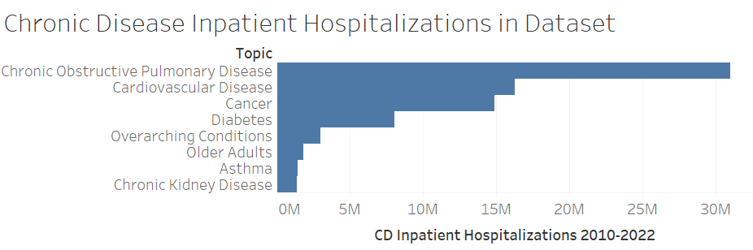
Based on Inpatient Hospitalizations

Slide 3
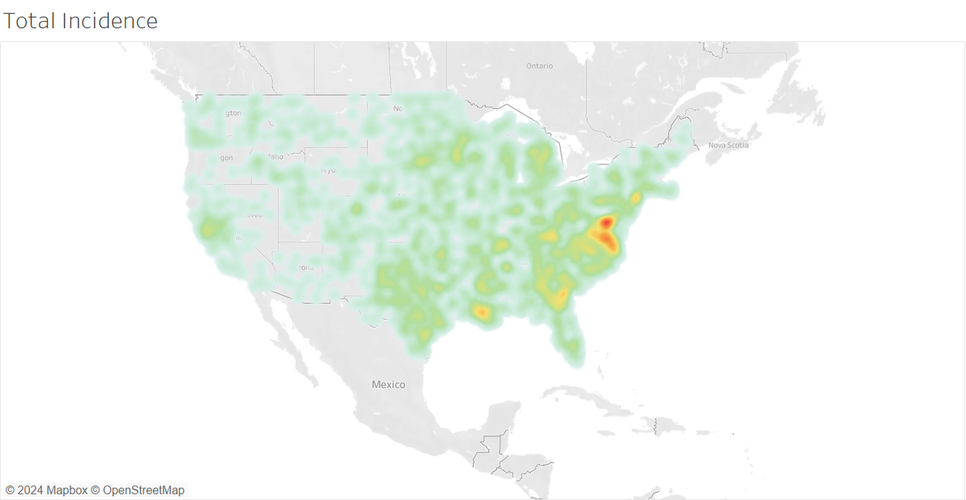
Where are the diseases?
Concentrations:
Washington DC / Virginia
Southeast
Diseases shown:
Chronic Obstructive Pulmonary Disease
Cardiovascular Disease
Cancer
Diabetes
Asthma
Chronic Kidney Disease

Slide 4
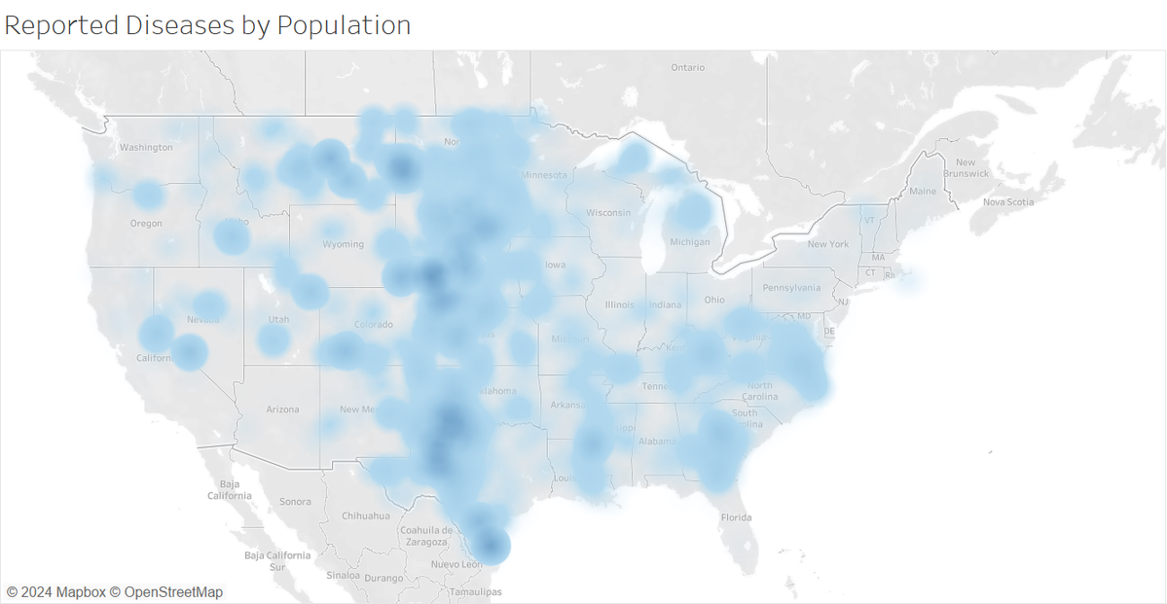
Where are the Diseases by Population?
Concentration:
South Texas through North Dakota
Diseases shown:
Chronic Obstructive Pulmonary Disease
Cardiovascular Disease
Cancer
Diabetes
Asthma
Chronic Kidney Disease
**Incidence divided by local population count

Slide 5
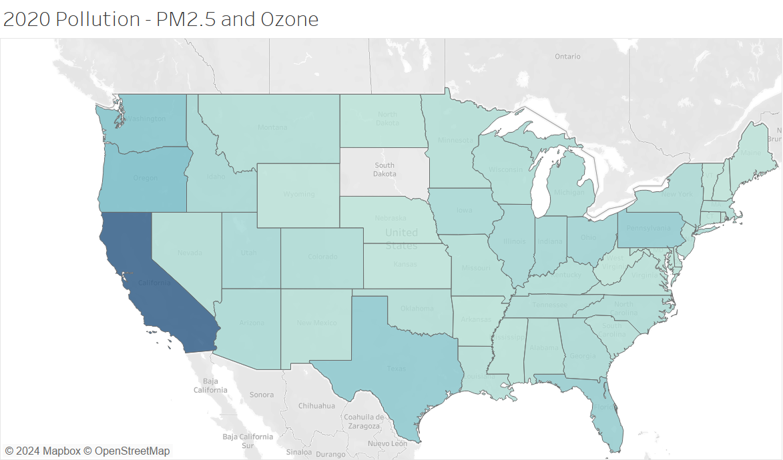
Where is the air pollution?
California
Washington
Oregon

Slide 6
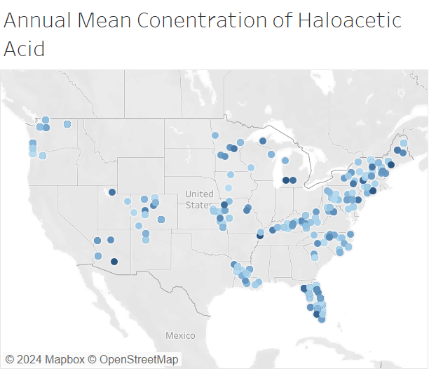
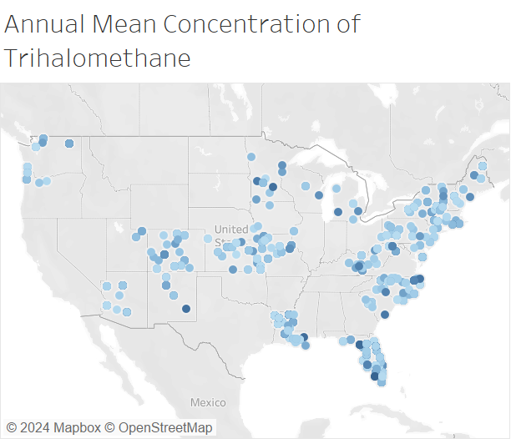
Where is the Water Pollution?
Haloacetic Acid
Trihalomethane

Slide 7
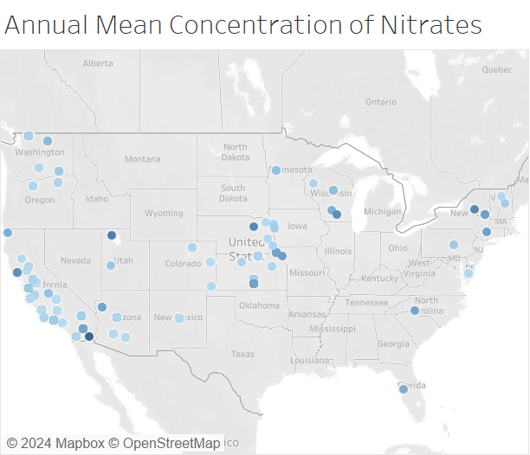
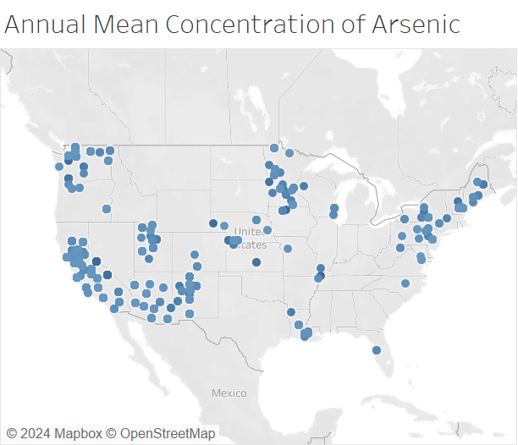
Where is the Water Pollution?
Nitrates
Arsenic

Slide 8
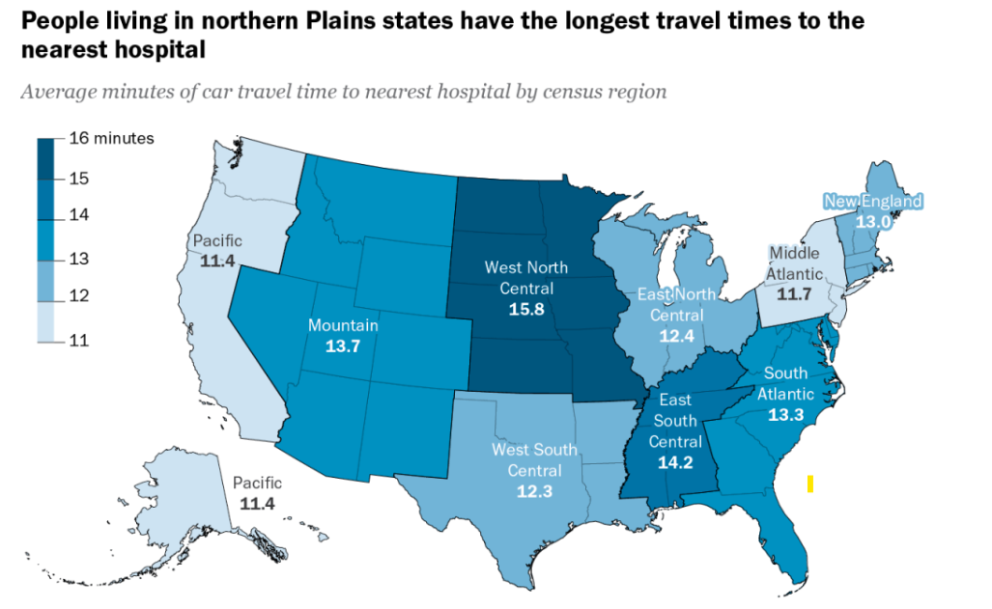
Access to Healthcare by Distance to Nearest Hospital:
Possible that more difficult access to hospitals/specialists in plains area preventing patients from catching diseases in early phase.
*Pew Research

Slide 9

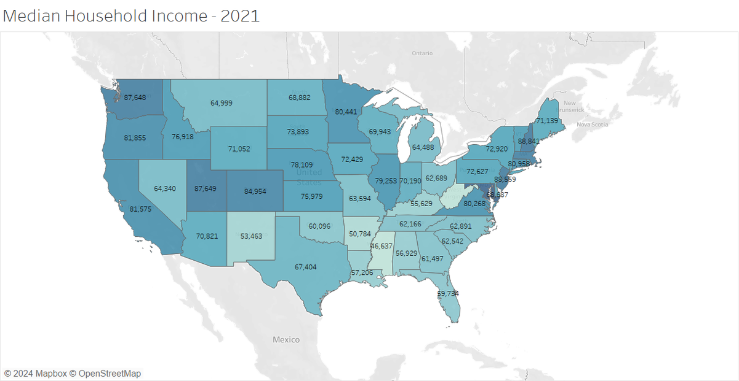
Where Is the Money?

Slide 10
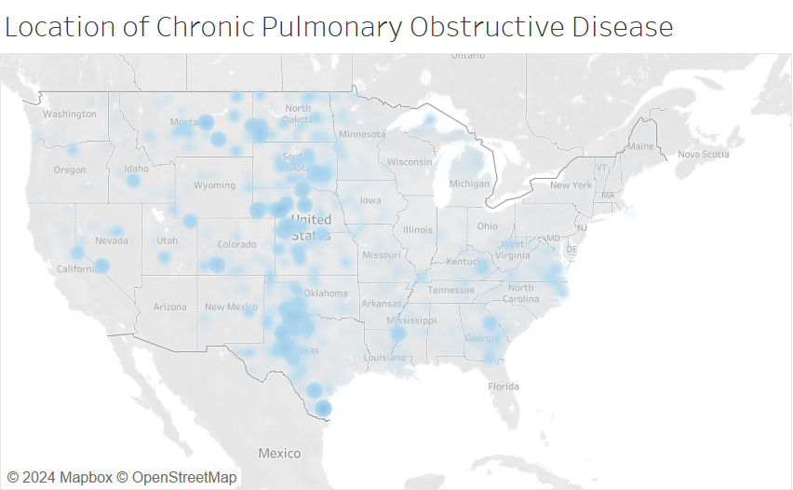
Where i s Chronic Obstructive Pulmonary Disease by Population?
Concentration:
South and East Texas through North Dakota
According to American Lung Association:
Rates of COPD are 60% higher in rural areas compared to urban.
Smoking
Access to healthcare
NOTE: Texas rates are low in major cities
**Incidence divided by local population count

Slide 11
Current Smokers - State Rankings
Rank | State | Current Smokers | Current Smokers Percentage
12 | Oklahoma | 576,977 | 20.10%
13 | Michigan | 1,441,675 | 19.30%
14 | South Dakota | 124,347 | 19.30%
15 | South Carolina | 711,229 | 18.80%
16 | Pennsylvania | 1,837,177 | 18.70%
17 | Wyoming | 82,278 | 18.70%
18 | North Dakota | 103,343 | 18.30%
19 | Nevada | 394,177 | 17.60%
20 | Georgia | 1,307,100 | 17.50%
21 | New Mexico | 264,465 | 17.50%
22 | Kansas | 360,137 | 17.40%
23 | Maine | 179,036 | 17.30%
24 | Montana | 138,198 | 17.20%
5 out of 6 in COPD mid-country cluster are above average in smoking rates by population

Slide 12

In Conclusion:
Chronic diseases (Due in large part to COPD) seem to favor the Mid-West:
-Rural
-Increased distance to hospitals
-Above-Average prevalence of smoking

